Slide 1
HCI - Assignment n.2
Design and prototyping of an application using a human-centered approach
Final presentation and Demo
Project Title: Bee in Control
Group: G2, Lúcia Sousa 93086, Raquel Pinto 92948, Rodrigo Martins 93264
Lab Class: P4

Slide 2
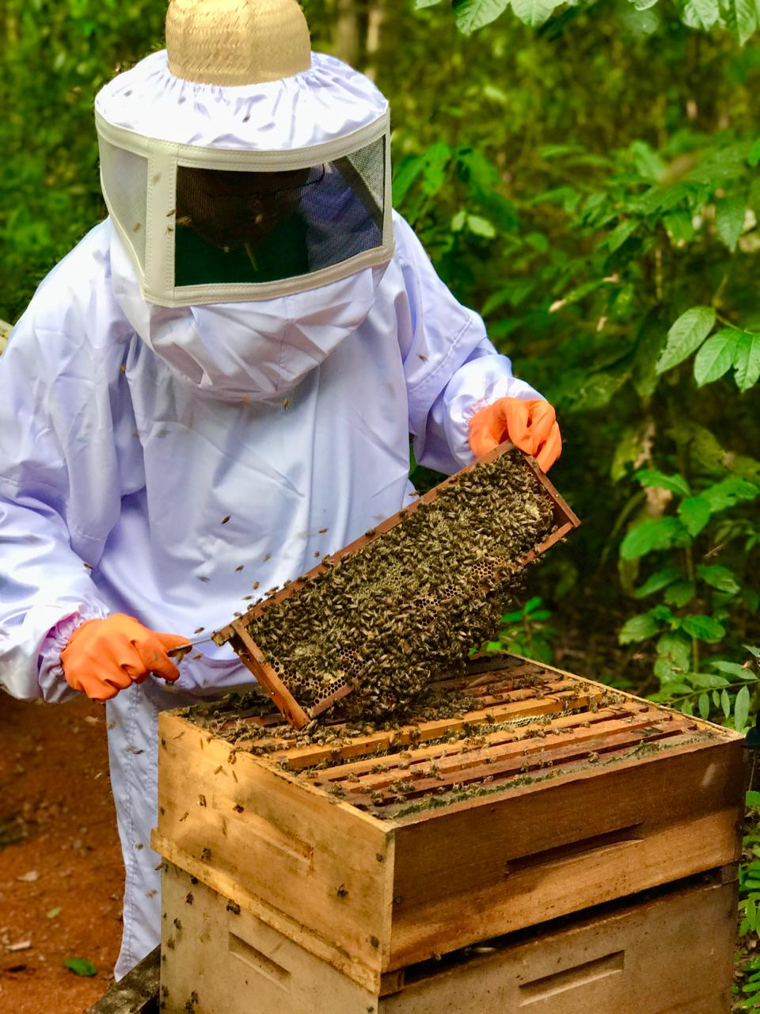
Introduction
Bee in Control
Application to help beekeepers keep track of their beehives;
We know what difficulties beekeepers have and we wanted to help;
Related to Databases project.

Slide 3

Project Objectives
Bee in Control
Provide an easy to use, yet complete application that can help you keep track of the state of your apiaries;
Keep information of beehives;
Track the evolution and the needs of beehives;
Keep a list of specific tasks the user needs to do.
Benefits:
Portable because it can be accessed through your phone or tablet;
No need to keep a paper records of all things;
Practical because the user can take the application while doing the job.

Slide 4


Personas
Bee in Control
Name | Manuel Ribeiro
Gender | Male
Demographics | 44 years old Has a Master’s degree in History Education
Profession | High School History Teacher
Tasks | Preparing lessons Grading students’ tests
Background | Practices beekeeping in his spare time
Name | Rosalinda Neto
Gender | Female
Demographics | 58 years old Studied until 6th grade
Profession | Beekeeper
Tasks | Collecting honey Record the last honey harvest Keep track of treatments
Background | Likes to garden whenever she can

Slide 5
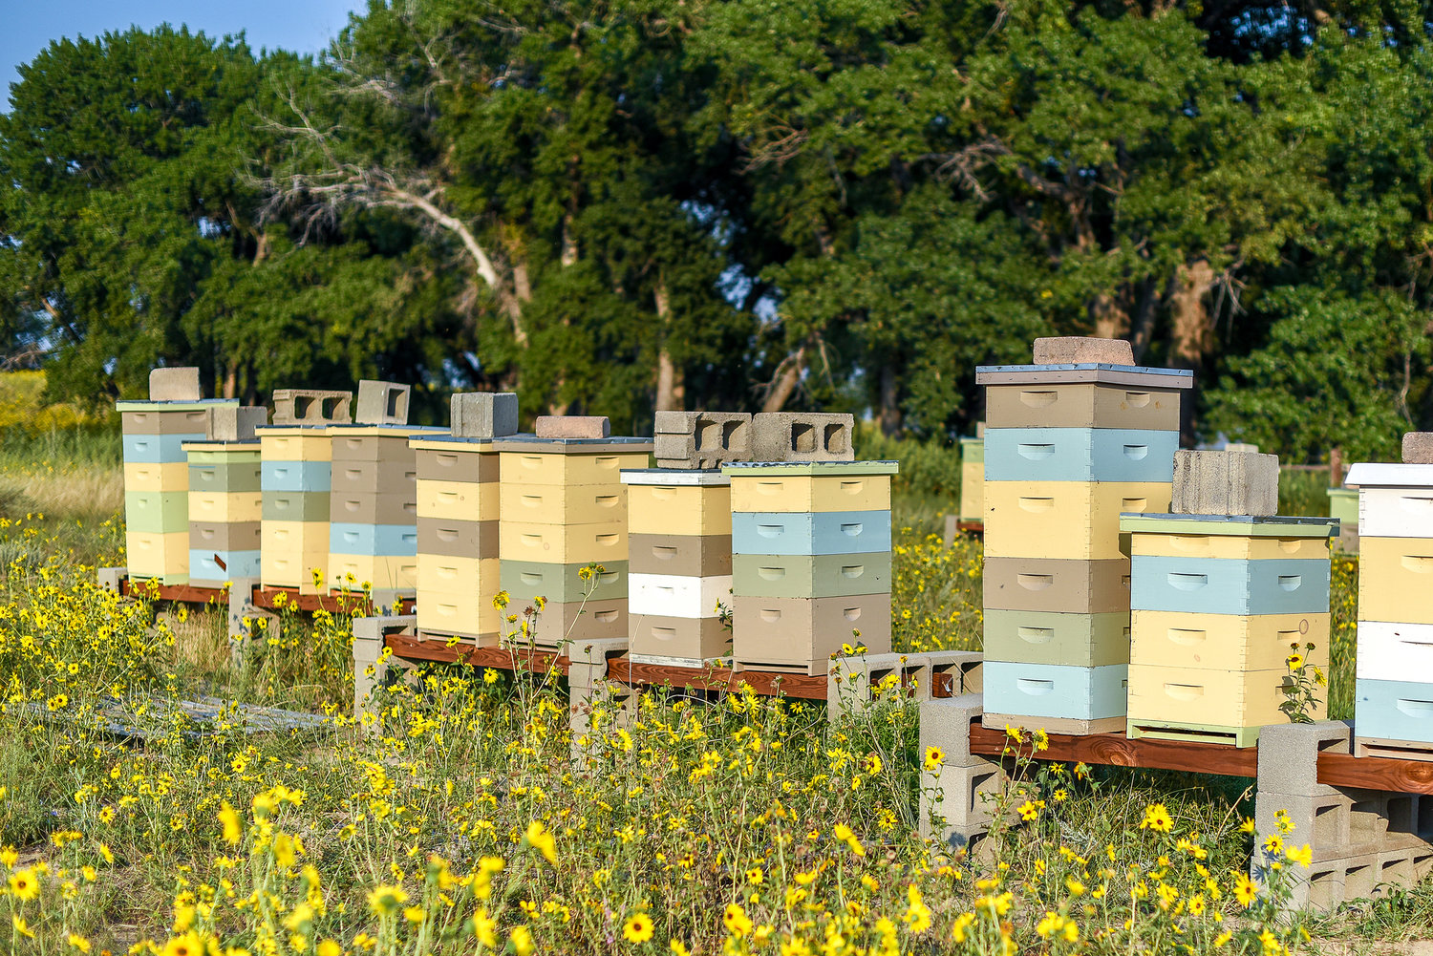
Scenarios
Bee in Control
Manuel comes home tired from work and it happens that he forgets what he has to do in his apiary and needs to write down all the tasks he has to do for certain beehives.
Rosalinda can't find the date of the last honey harvest. She needs to have all the necessary information intact and in one place, where she can look up what she wants quickly and easily.

Slide 6
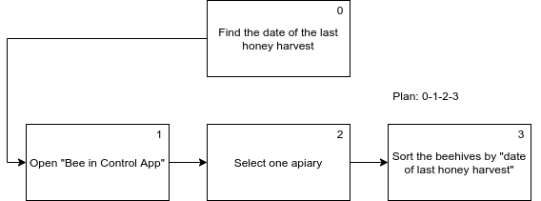
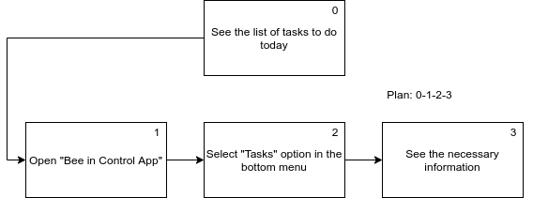
Tasks
Bee in Control

Slide 7
Requirements
Bee in Control
Non-functional requirements
Functional Requirements
Simple, intuitive and easy to learn application;
Complete application.
Save, display and modify information;
Add beehives, tasks, treatments;
Register the last harvest;
The food given to the bees.

Slide 8
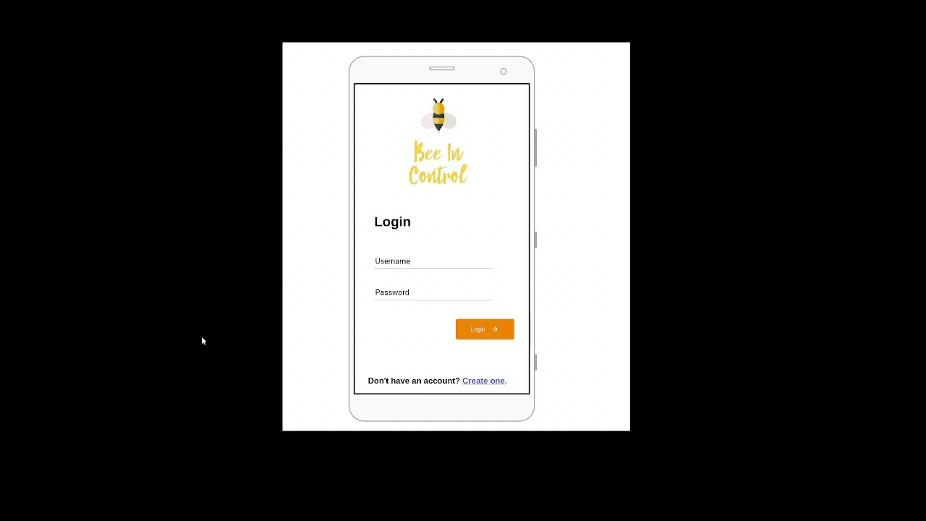
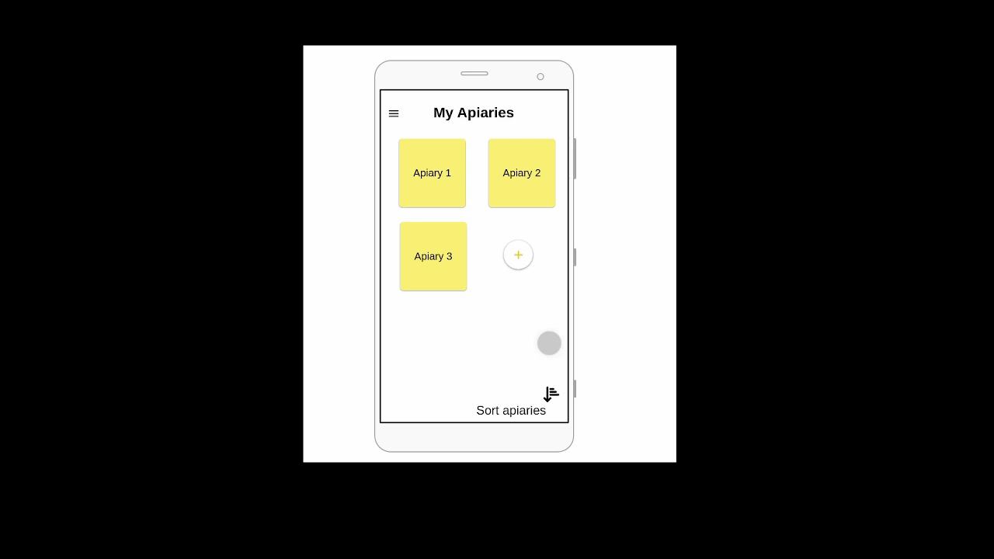
Low Fidelity Prototype
Bee in Control
Digital Prototype, proto.io
Simple and intuitive
Sign in
Sort apiaries by number of beehives

Slide 9
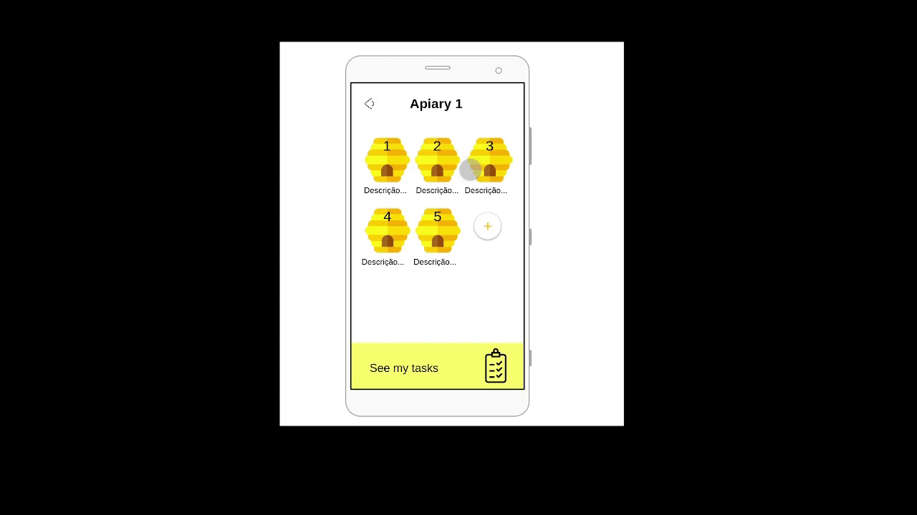
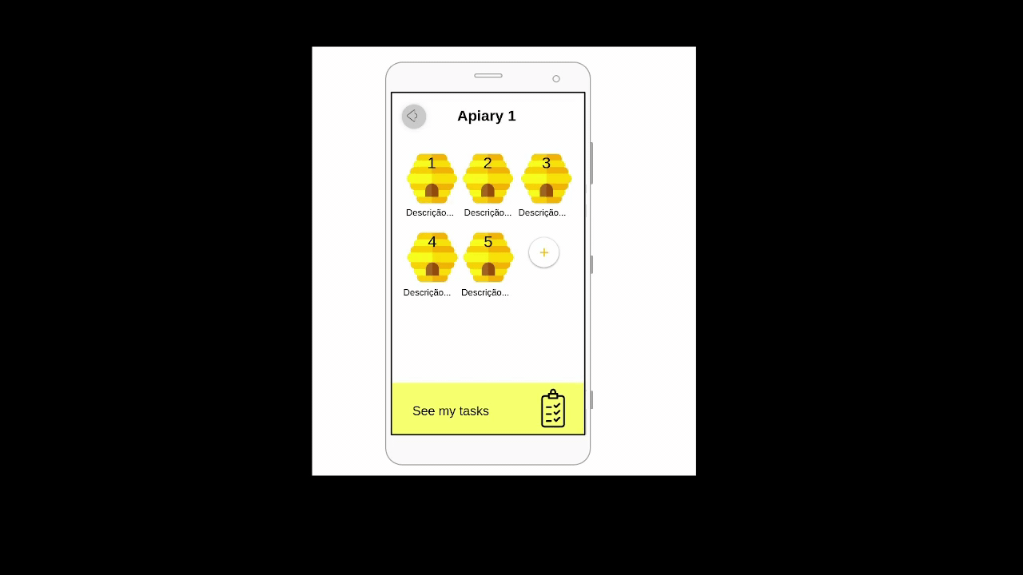
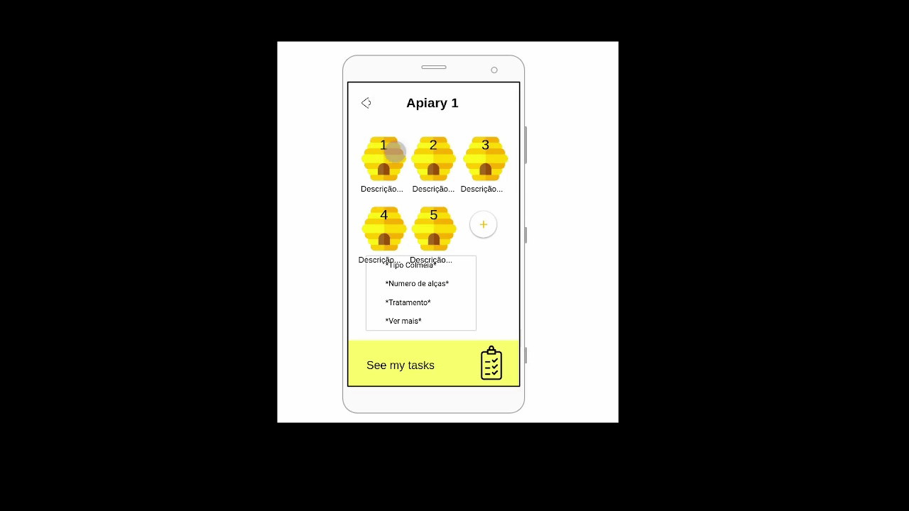
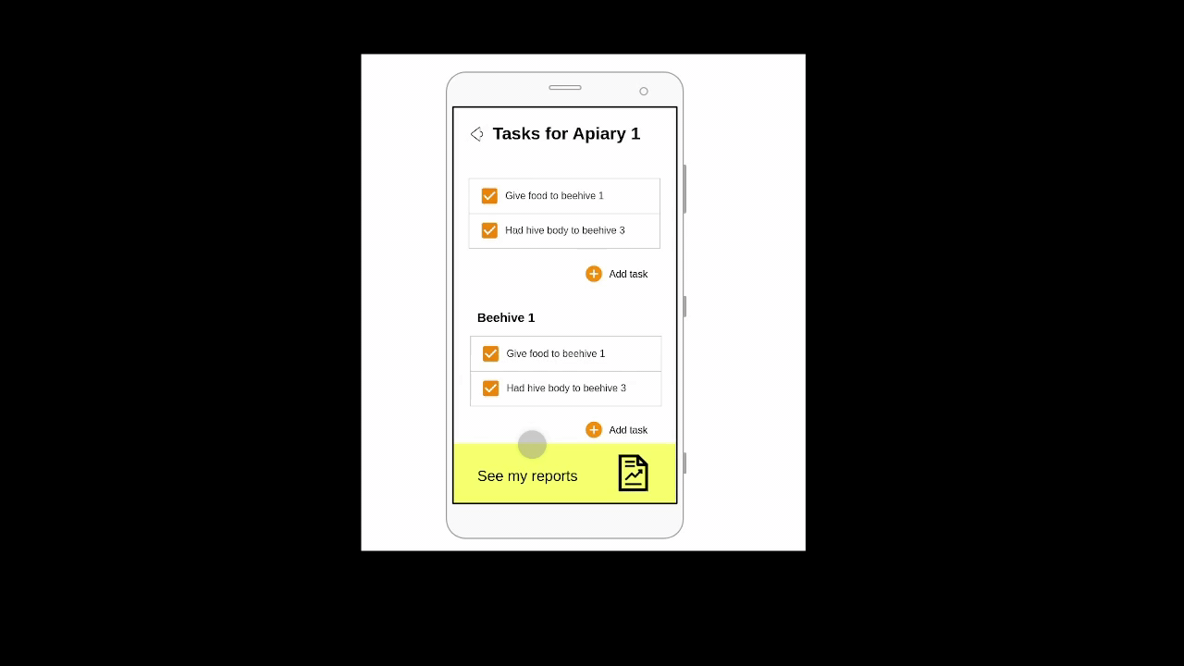
Low Fidelity Prototype
See information about beehive
Add beehive
See tasks
See reports
Bee in Control

Slide 10
LFP User Evaluation
Bee in Control
1- Create an account.
2- View the task list of apiary 1.
3- Check the date of the last harvest of beehive 1, from apiary 1.
4- Add a new beehive.
5- Add a new apiary.
6- Find the help/documentation.
7- Add a task in apiary 1.
8- Find the beehive in apiary 3 where the most recent harvest was done.
9- Find the apiaries with more beehives, select the first apiary, find the beehive with less hive body and find that number.

Slide 11
LFP User Evaluation
Bee in Control
Task | Median | Time (s)
1- Create an account. | 5 | 4.30
2- View the task list of apiary 1. | 5 | 18.20
3- Check the date of the last harvest of hive 1, from apiary 1. | 5 | 21.45
4- Add new beehive. | 5 | 9.10
5- Add new apiary. | 5 | 14.50
6- Find help/documentation. | 5 | 30.40
7- Add task in apiary 1. | 5 | 10.10
8- Find the beehive in apiary 3 where the most recent harvest was done. | 4 | 50.12
9- Find the apiaries with more hives, select the first apiary, find the hive with less handles and find that number. | 5 | 40.30
Participants:
4 males, 1 female

Slide 12
LFP User Evaluation
Bee in Control
Task | User 1 | User 2 | User 3 | User 4 | User 5
1- Create an account. | 5 | 5 | 5 | 5 | 5
2- View the task list of apiary 1. | 5 | 5 | 5 | 5 | 5
3- Check the date of the last harvest of hive 1, from apiary 1. | 3 | 4 | 5 | 5 | 4
4- Add new beehive. | 5 | 5 | 5 | 5 | 5
5- Add new apiary. | 5 | 5 | 5 | 5 | 5
6- Find help/documentation. | 5 | 5 | 5 | 5 | 5
7- Add task in apiary 1. | 5 | 5 | 5 | 5 | 4
8- Find the beehive in apiary 3 where the most recent harvest was done. | 2 | 4 | 4 | 4 | 5
9- Find the apiaries with more hives, select the first apiary, find the hive with less handles and find that number. | 5 | 5 | 3 | 5 | 5

Slide 13
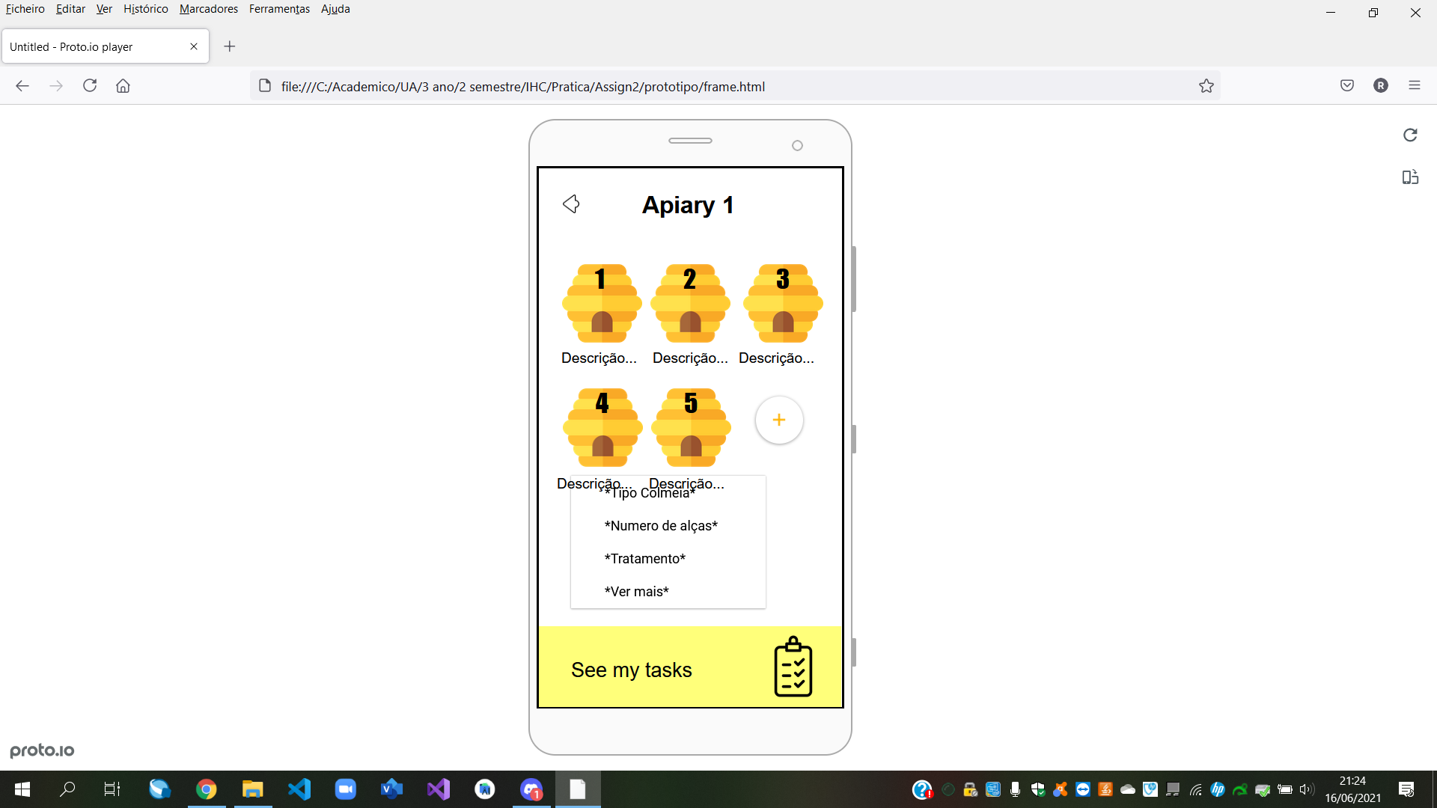
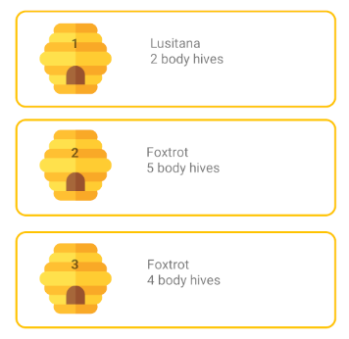
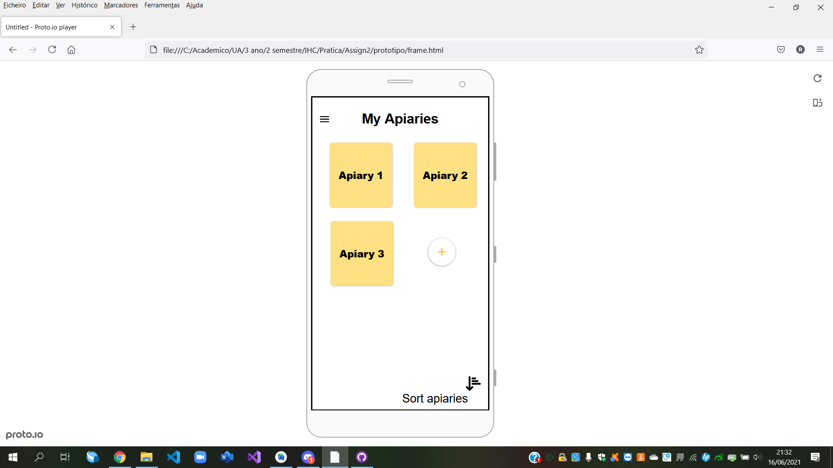
LFP User Evaluation
Bee in Control
Problems | Solutions
The onclick information preview about the beehives | Add some static information
The colors, white on yellow | Black on yellow
The sort button more visible, button only with an icon | Button with icon and label

Slide 14


Platform used for the functional prototype
Bee in Control
Android Studio
AnyChart-Android for Reports

Slide 15
User Evaluation of the functional prototype
Bee in Control
1- Create an account.
2- View the task list of apiary 1.
3- Check the date of the last harvest of beehive 1, from apiary 1.
4- Add a new beehive.
5- Add a new apiary.
6- Find the help/documentation.
7- Add a task in apiary 1.

Slide 16
User Evaluation of the functional prototype
Bee in Control
Task | Median | Time(s)
1- Create an account. | 5 | 4.13
2- View the task list of apiary 1. | 5 | 17.80
3- Check the date of the last harvest of hive 1, from apiary 1. | 5 | 20.73
4- Add new beehive. | 5 | 9.04
5- Add new apiary. | 5 | 15.01
6- Find help/documentation. | 4 | 26.78
7- Add task in apiary 1. | 5 | 8.00
Participants:
4 males, 1 females

Slide 17
User Evaluation of the functional prototype
Bee in Control
Task | Person 1 | Person 2 | Person 3 | Person 4 | Person 5
1- Create an account. | 5 | 5 | 5 | 5 | 5
2- View the task list of apiary 1. | 5 | 5 | 5 | 5 | 5
3- Check the date of the last harvest of hive 1, from apiary 1. | 5 | 5 | 5 | 5 | 5
4- Add new beehive. | 5 | 5 | 5 | 5 | 5
5- Add new apiary. | 5 | 5 | 5 | 5 | 5
6- Find help/documentation. | 5 | 3 | 4 | 4 | 3
7- Add task in apiary 1. | 5 | 5 | 5 | 5 | 5

Slide 18
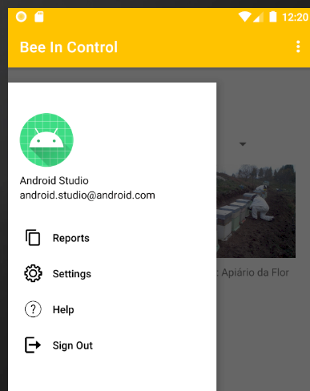
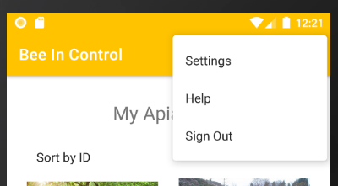
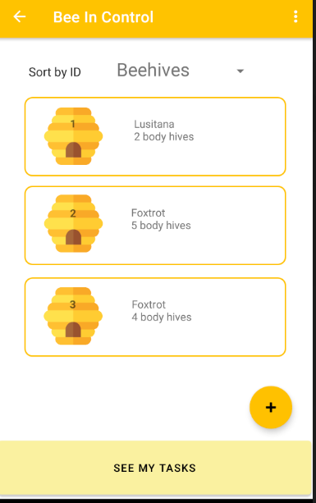
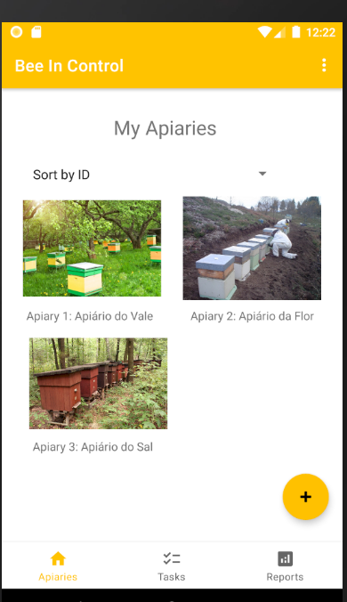
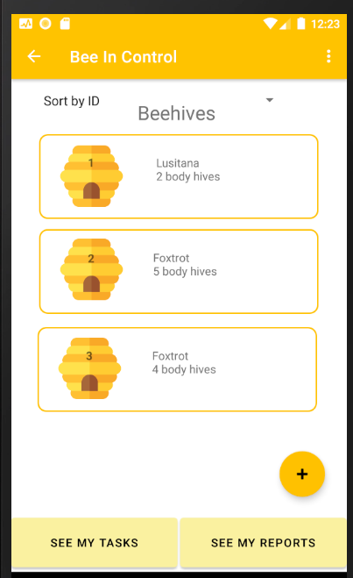
User Evaluation of the functional prototype
Bee in Control
Problems | Solutions
Find help | Make the symbol more noticeable
See tasks button not relevant enough | Make the button more relevant and by adding better contrast
Report button too hidden | We added the button to the beehives page
Put the three dots on every page | We add this

Slide 19
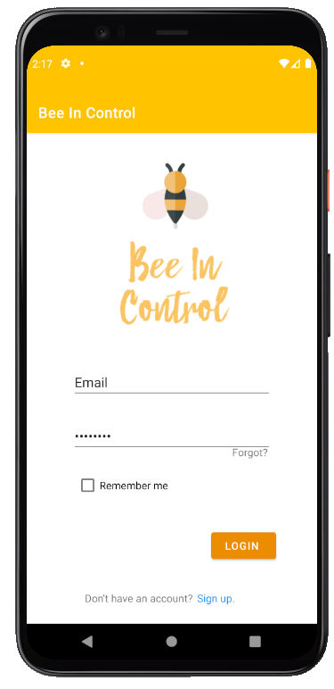
Demo
Bee in Control

Slide 20
Future work
Bee in Control
Integrate the database with this interface that was developed in the Databases project.
Effort of each group member
33% for each.

Slide 21
Acknowledgments
Bibliography
Bee in Control
People who helped us with the usability tests;
Availability of the teachers to answer our questions.
Android studio documentation
AnyChart Library

